Slide 1
Cognition Fundamentals: Decision-making & Actions
How do we learn from our perceptions?
Responsible Lecturer: Bram Heijligers

Slide 2
What we learn and why
Learning Objectives
Sample relevant real-world input required for situational awareness & reinforcement learning.
Sample cognitive processes used to process relevant real-world input required for situational awareness & reinforcement learning.
Using situational awareness & reinforcement learning to respond.
→ feeds into our reinforcement learning algorithm & symbolic AI and helps to optimize it

Slide 3


Slide 4
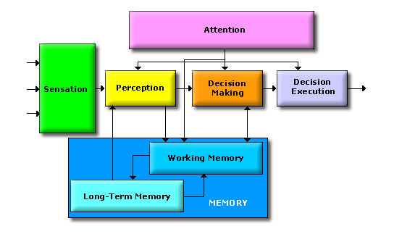
The Cognitive System

Slide 5


Rewards & Motivation
Motivation is what motivates us; lies at the base of intelligence
Reinforcement Learning is learning what to do and how to map situations to actions. The end result is to maximize the numerical reward signal. The learner is not told which action to take, but instead must discover which action will yield the maximum reward.

Slide 6
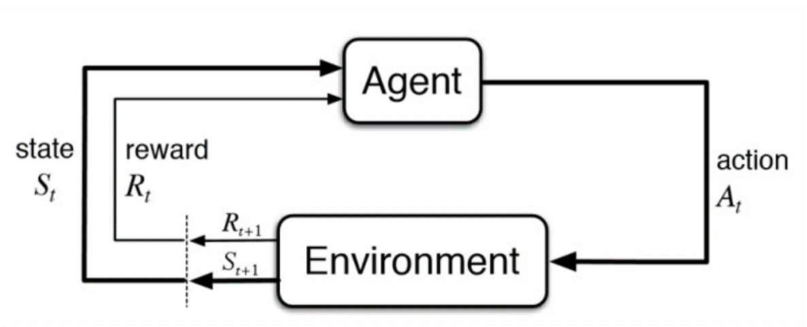
Reinforcement Learning

Slide 7
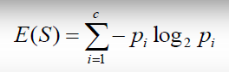
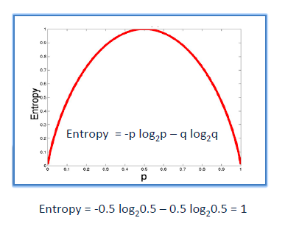
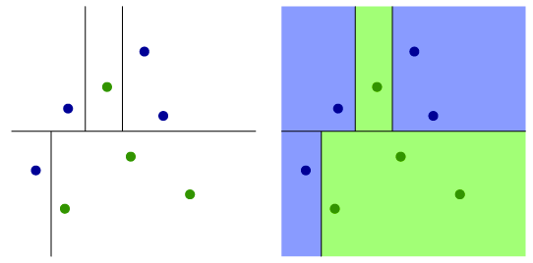
Information gain/Reduction of Uncertainty
It is like playing “20 questions”
ENTROPY = measure of disorder of a system
Zero entropy ~ completely homogeneous sample
Entropy = 1 ~ the sample is equally divided
ENTROPY

Slide 8
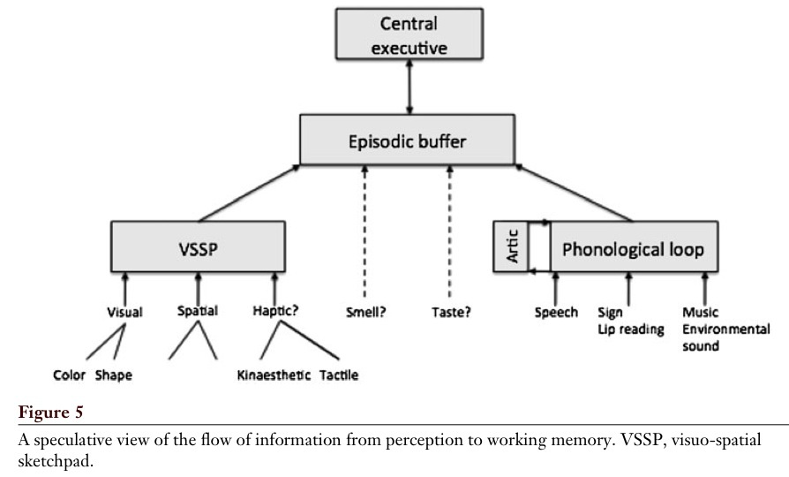
Working Memory
Baddeley, 2012

Slide 9
Central executive
Most important component of WM
Has limited capacity, deals with demanding cognitive tasks, resembles attention
Is related to executive processes (processes that organize and coordinate the functioning of the cognitive system to achieve current goals)
Baddeley (1996 – cf. Miyake et al.):
- focusing attention or concentration
- dividing attention between two stimulus streams
- switching attention between tasks
- interfacing with long-term memory

Slide 10
LTM: Familiarity vs. Recollection
Familiarity – observer knowing an item is old or new, without having specific details associated with that memory; the process of recognizing an item on the basis of its perceived memory strength but without retrieval of any specific details about the study episode
Recollection – observer accessing specific details about a previously experienced item

Slide 11
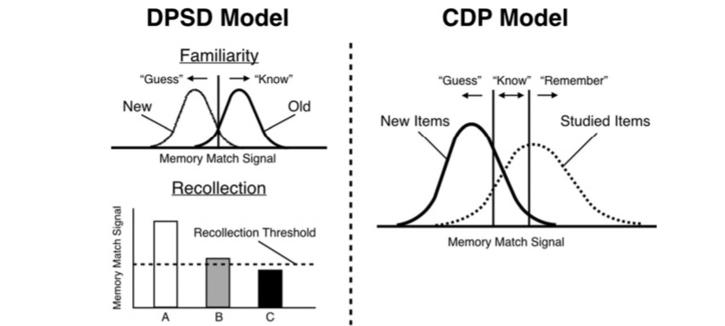
Familiarity vs. Recollection: The DPSD and CDP Models
Notes:
DPSD = dual-process signal-detection
CDP = continuous dual process

